Slide 1

BACHELOR OF TECHNOLOGY
IN
ELECTRONICS AND COMMUNICATION ENGINEERING
BONAM VENKATA CHALAMAYYA ENGINEERING COLLEGE
ODALAREVU-533210
2021-2025
Under the Esteemed Guidance of
Mrs. K. Swathi M.TECH
Assistant Professor
ECE Department
Presenting by
A.Durga Lakshmana Prasad(21221A0411)
CH.Pavani Swarna Satya(21221A0436)
CH.Venkata Vijaya Naga Padmini(21221A0432)
B.Vamsi(21221A0418)

Slide 2
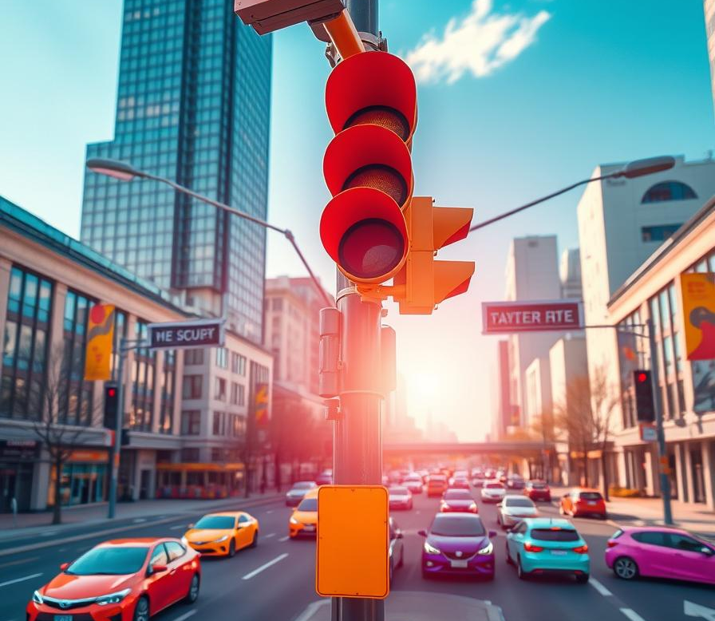
Traffic Density-Based
Signal Timing Control System

Slide 3
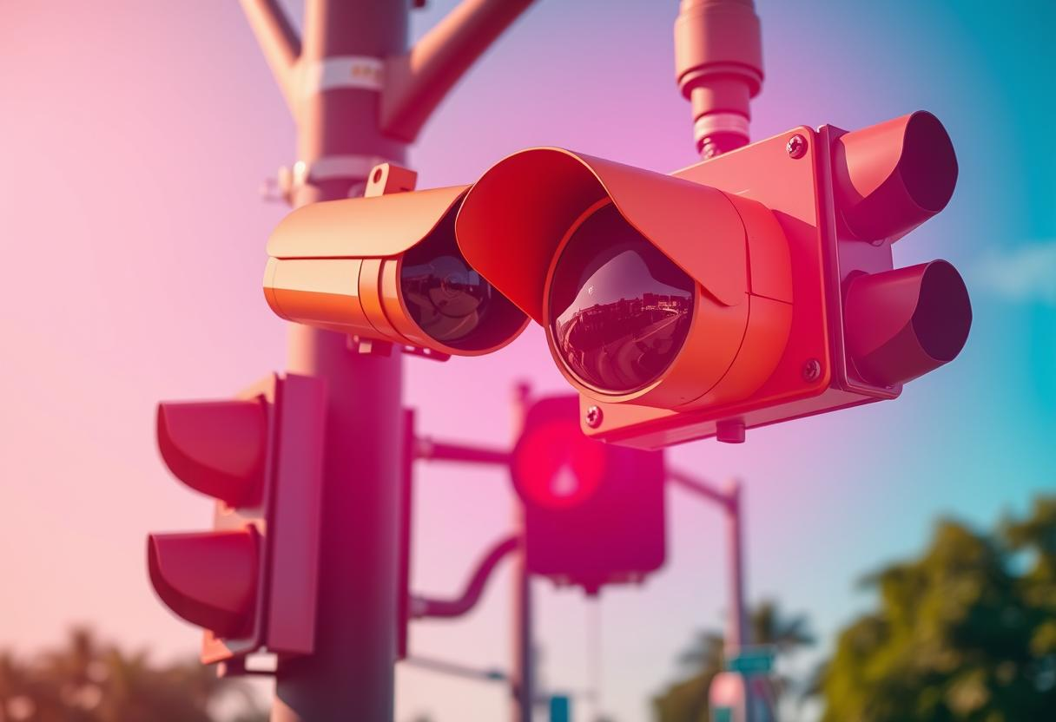
LIST OF CONTENTS:
Objective
Abstract
Introduction
Literature Overview
Key - Components
Software used
Block Diagram
Flow Chart
Circuit Diagram
Methodology
Advantages
Disadvantages
Applications
Conclusion

Slide 4
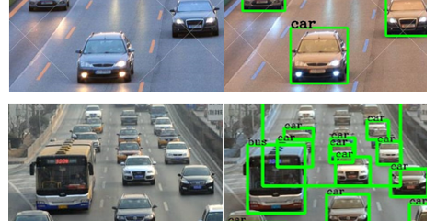
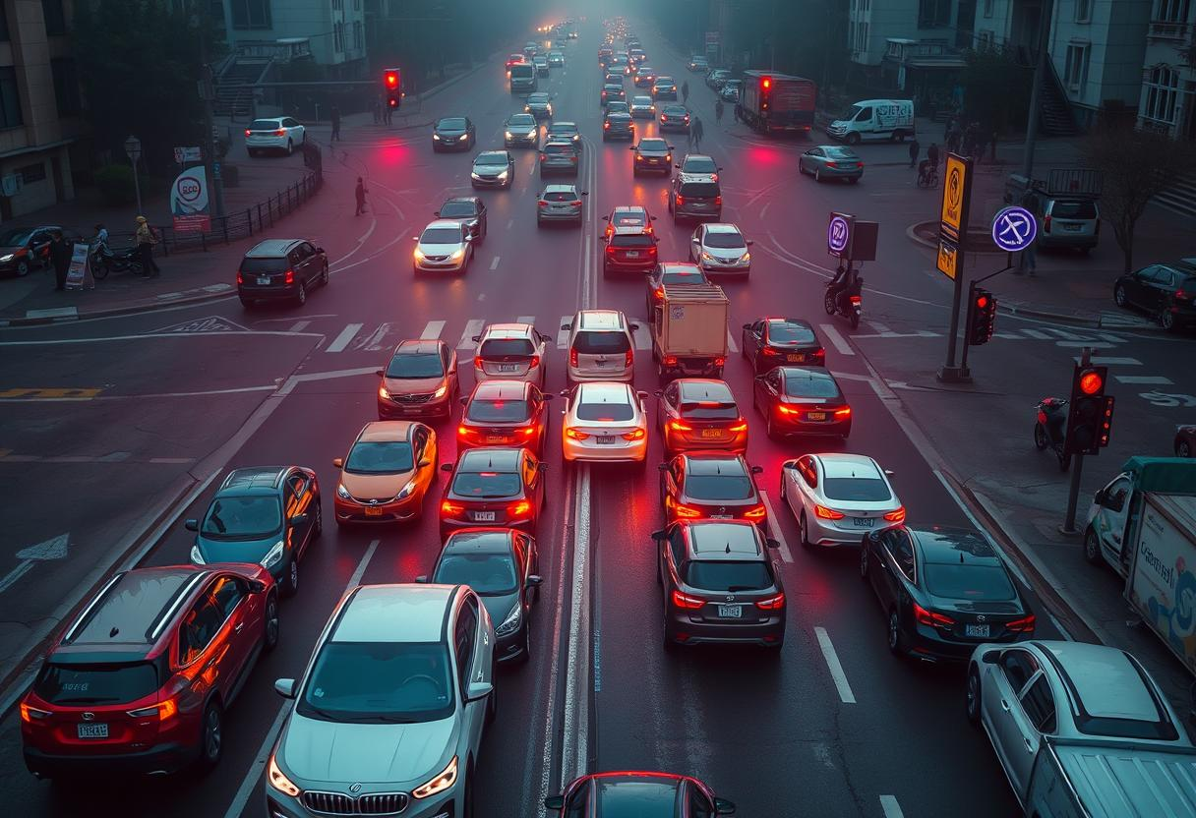
OBJECTIVE :
Goal :
To develop an intelligent traffic signal control system that dynamically adjusts signal timing based on real-time traffic density, reducing congestion and improving road efficiency. Minimize vehicle wait times and enhance overall transportation efficiency by prioritizing high-density traffic lanes.
Target :
Design an adaptive signal control mechanism that responds to traffic conditions and ensures equitable traffic distribution. Implement sensors or cameras to collect traffic data and use algorithms to optimize signal timing for smoother traffic flow.

Slide 5
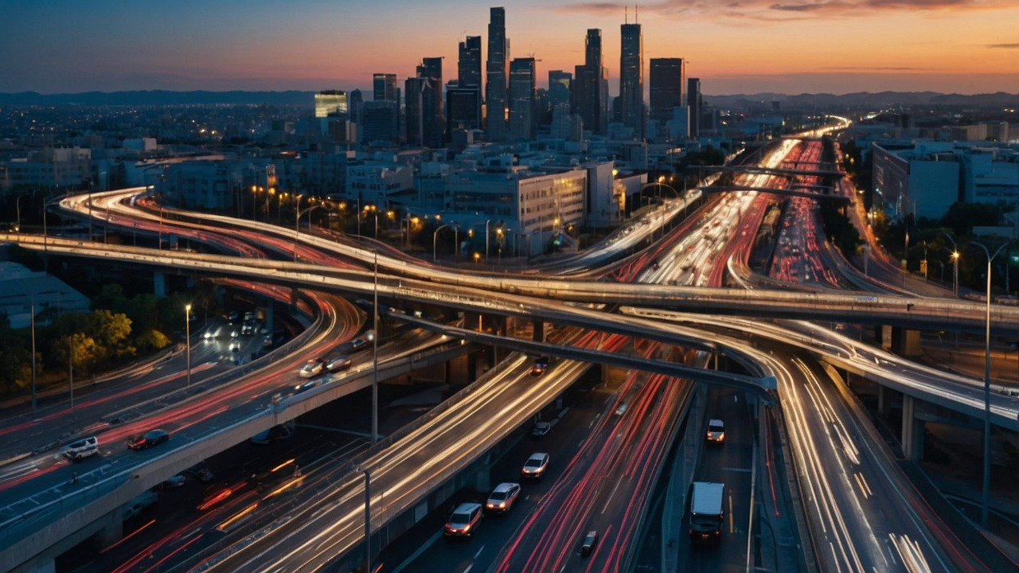
ABSTRACT :
The Traffic Density-Based Signal Timing Control project focuses on improving urban traffic management by dynamically adjusting signal timings based on real-time traffic conditions. The system uses advanced sensors like infrared, radar, and cameras to monitor traffic density at intersections. Data collected is processed using IoT and algorithms to calculate optimal signal durations. This smart system reduces congestion, fuel consumption, and emissions, while providing valuable insights to traffic authorities for better planning. Scalable and efficient, it contributes to sustainable urban development and better commuting experiences.

Slide 6
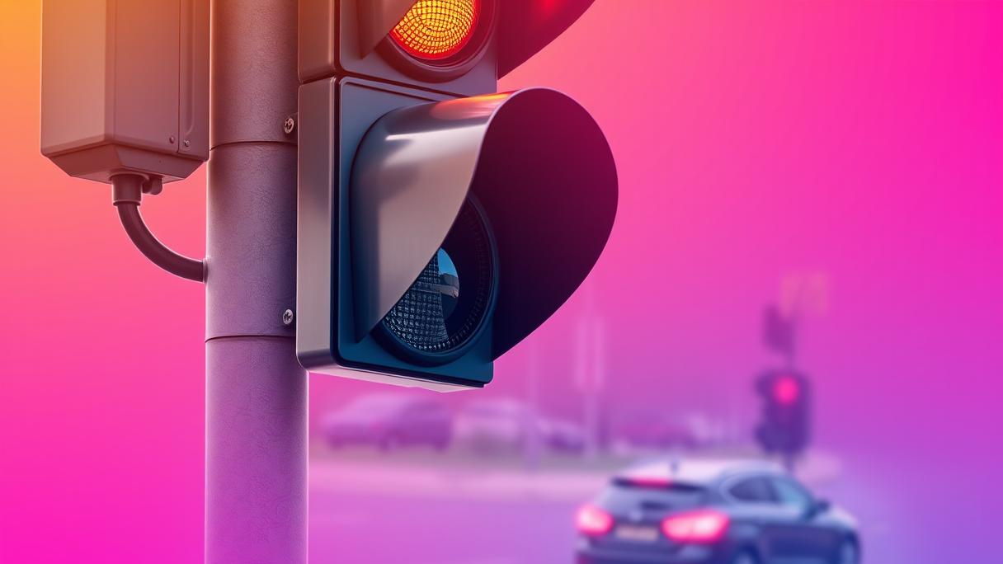
INTRODUCTION:
The Traffic Density Based Signal Control System aims to enhance urban traffic management by adjusting traffic signal timings in real-time based on the traffic conditions at intersections.
The system uses advanced sensors, such as cameras to monitor traffic density and adjust signal phases accordingly.
The Project offers a sustainable, scalable solution to urban traffic challenges, promoting smoother travel, reduced emissions, and better overall transportation efficiency.

Slide 7
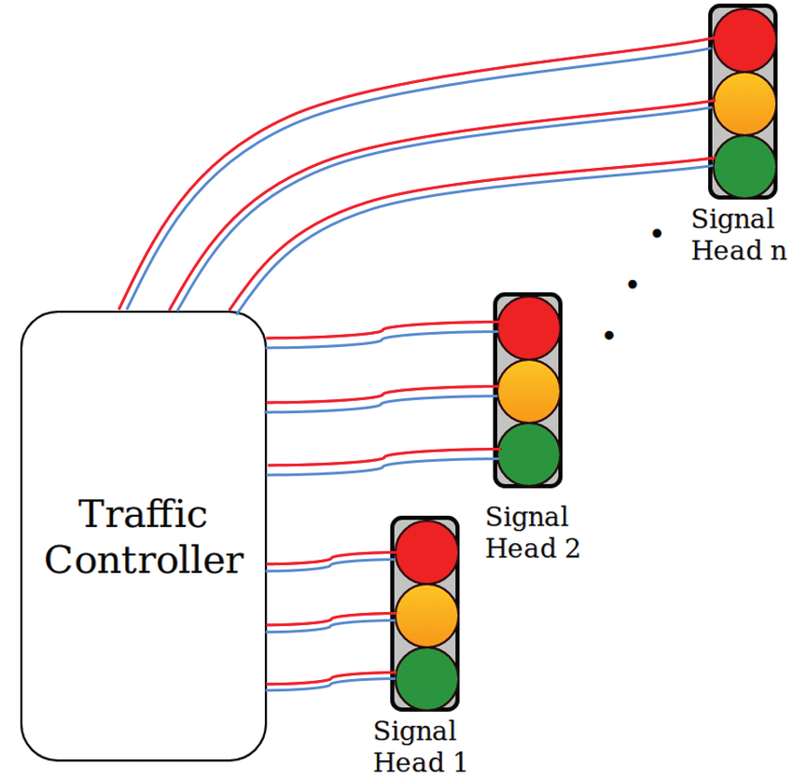
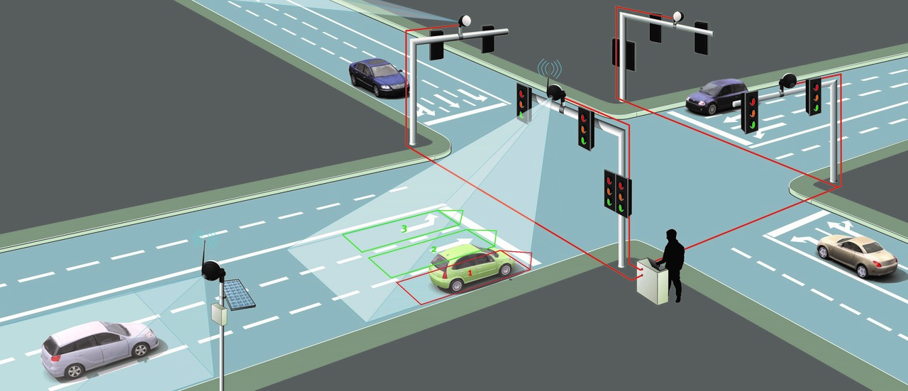
LITERATURE OVERVIEW:
1. Traditional Traffic Signal Control Systems:
Conventional traffic lights follow preset time cycles, which do not adapt to fluctuating traffic conditions. Fixed-time control systems can cause unnecessary delays during low-traffic periods and fail to handle congestion effectively. The vehicle-actuated control system was introduced to improve flexibility by detecting vehicles at intersections, but it still lacks advanced adaptability.
Adaptive Traffic Signal Control System
Traditional Traffic Signal Control System

Slide 8
2. Adaptive Traffic Signal Control Systems:
These systems use sensors, cameras, or GPS data to monitor real-time traffic flow and adjust signal timings dynamically. Algorithms analyze traffic patterns to predict congestion and optimize signal duration accordingly. Some systems integrate fuzzy logic-based decision-making and deep learning models for better signal optimization.
3. Technologies Used for Traffic Density Detection:
Conventional traffic lights follow preset time cycles, which do not adapt to fluctuating traffic conditions. Fixed-time control systems can cause unnecessary delays during low-traffic periods and fail to handle congestion effectively. The vehicle-actuated control system was introduced to improve flexibility by detecting vehicles at intersections, but it still lacks advanced adaptability.
4. Case Studies & Existing Systems:
Adaptive Traffic Control (ATC) systems are Implemented in cities like London (SCOOT system) and Los Angeles (ATCS system), reducing travel delays. Smart Traffic Management Systems are used by the Countries like Singapore and Japan utilize AI-driven traffic control to optimize urban mobility.

Slide 9
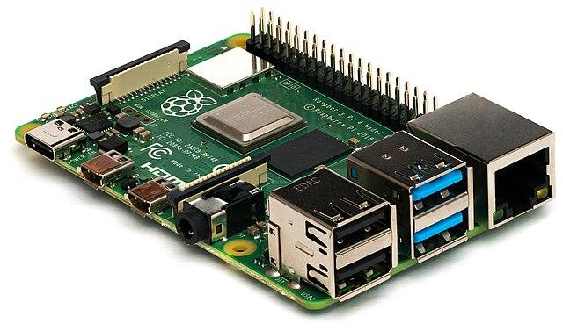
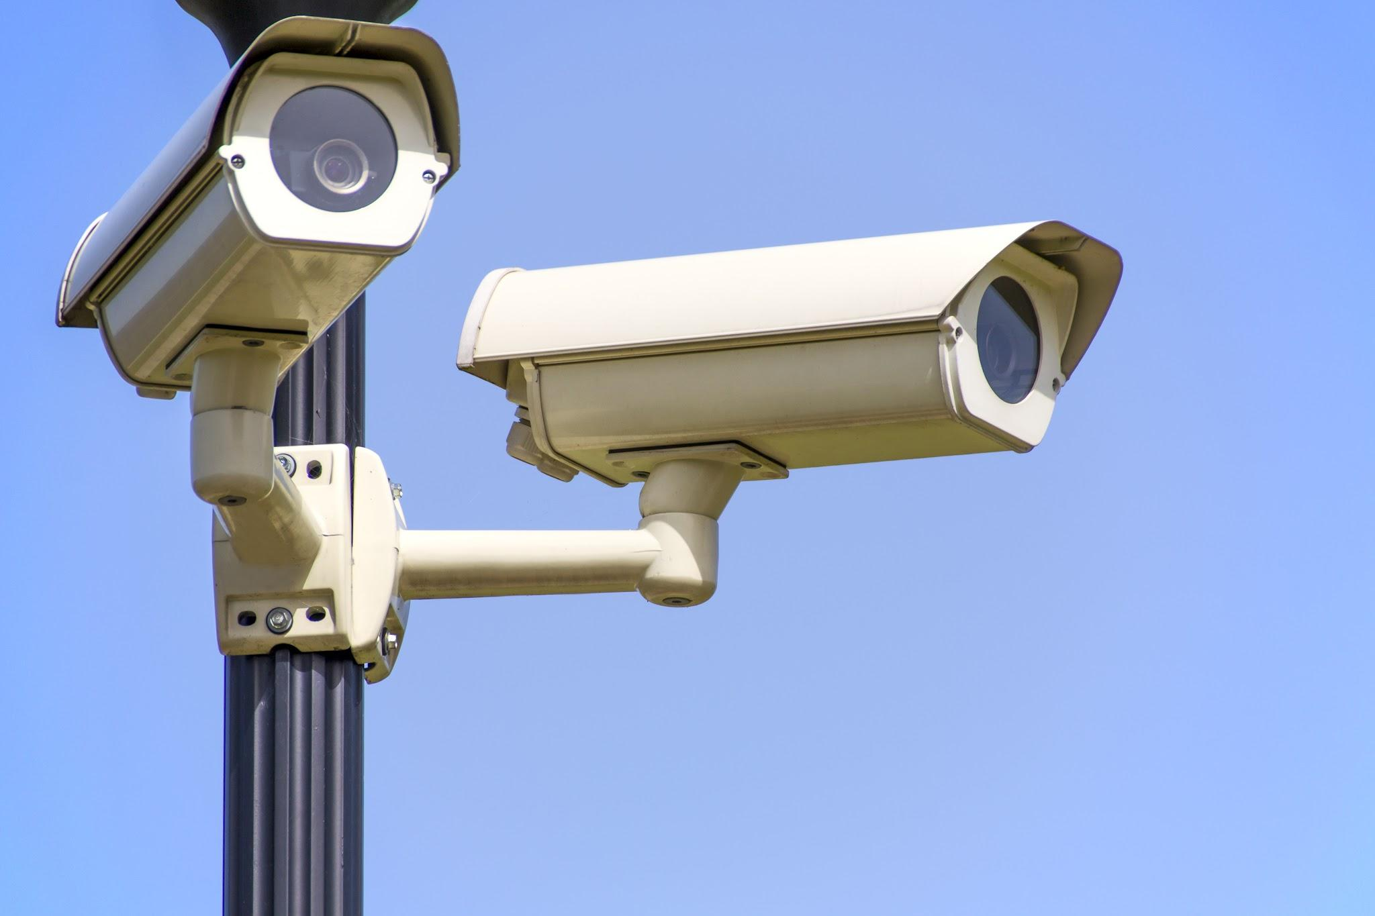

KEY – COMPONENTS:
Hardware Used :
Raspberry Pi (3 model B)
Cameras
LED Lights for Signals

Slide 10
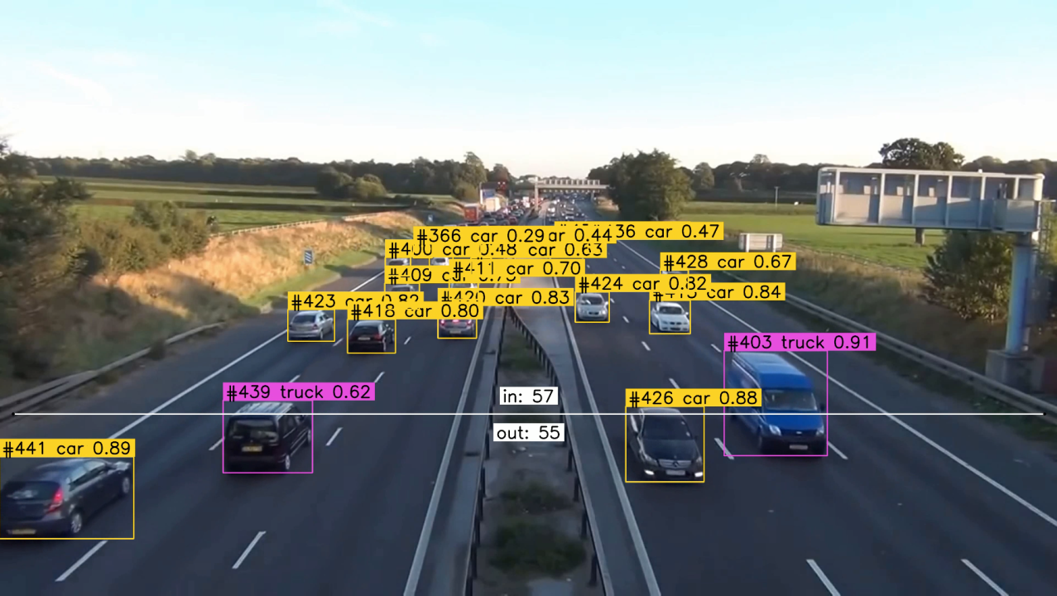



Software Used :
Raspbian Pi OS
Python Language
VS Code IDE
YOLO AI model

Slide 11
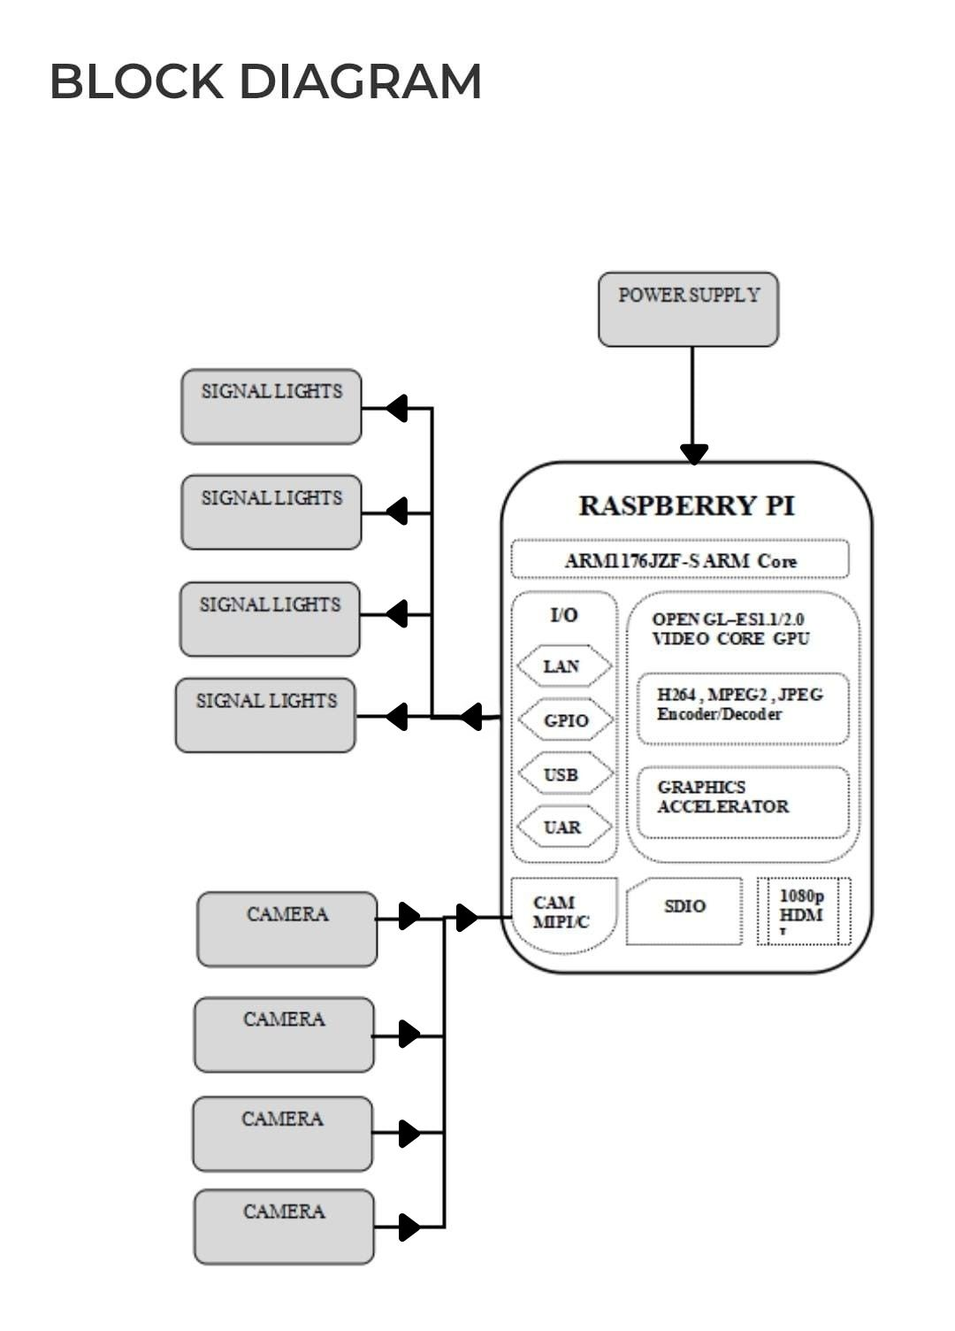
BLOCK DIAGRAM:

Slide 12
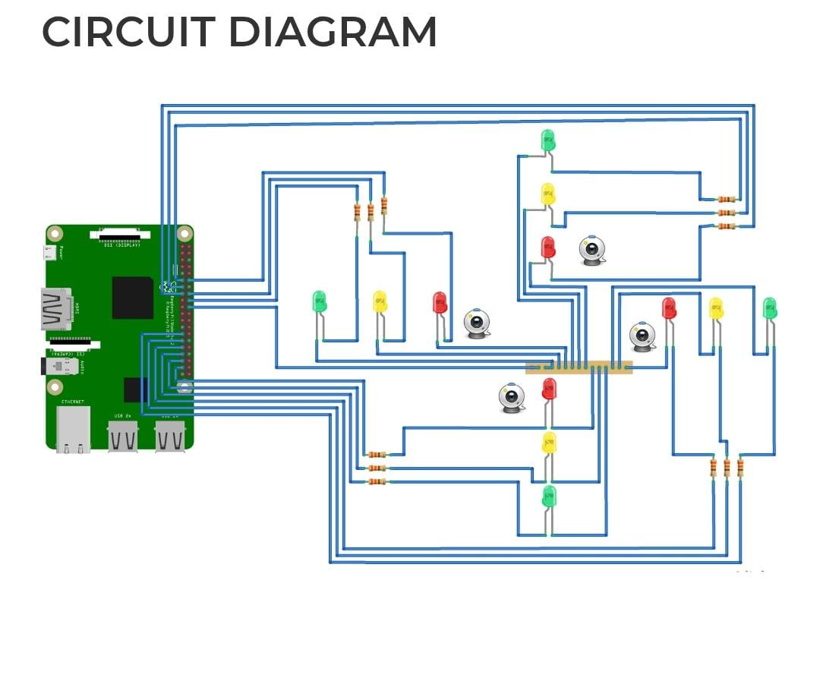
CIRCUIT DIAGRAM:
Cameras
LEDs
Raspberry Pi
Resistors

Slide 13
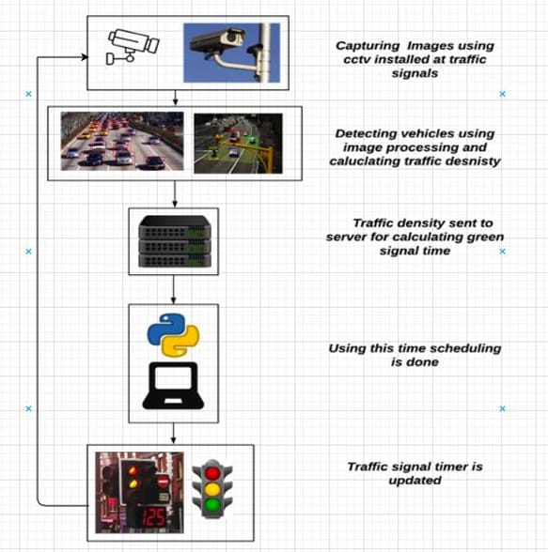
FLOW CHART:

Slide 14
METHODOLOGY :
This project integrates computer vision and embedded systems to dynamically control traffic signals based on real-time traffic density. The methodology is divided into hardware implementation, software development, and system integration.
1. Hardware Implementation:
-> Mount the camera at an optimal position to capture road traffic.
-> Connect the Raspberry Pi 3 Model B to the camera and traffic signal LEDs.
-> Configure power supply and GPIO pins for LED signal control.
2. Software Development:
-> Install Raspberry Pi OS and set up Python with necessary libraries (OpenCV, YOLOv5, TensorFlow).
-> Load a pre-trained YOLO model to detect vehicles.
-> Process video frames using OpenCV and apply YOLO for vehicle detection.
-> Count the number of vehicles in each lane.
3. System Integration:
-> Data Acquisition: The camera captures real-time traffic video.
-> Traffic Density Estimation: YOLO processes video frames to detect and count vehicles.
-> Decision Making: A Python-based algorithm determines optimal signal timing.
-> Traffic Light Control: Raspberry Pi controls LEDs based on the computed signal timing.
4. Testing & Optimization:
-> Test with different traffic conditions (low, medium, high density).
-> Optimize YOLO model parameters for better detection accuracy.
-> Adjust signal timing thresholds for efficient traffic flow.

Slide 15
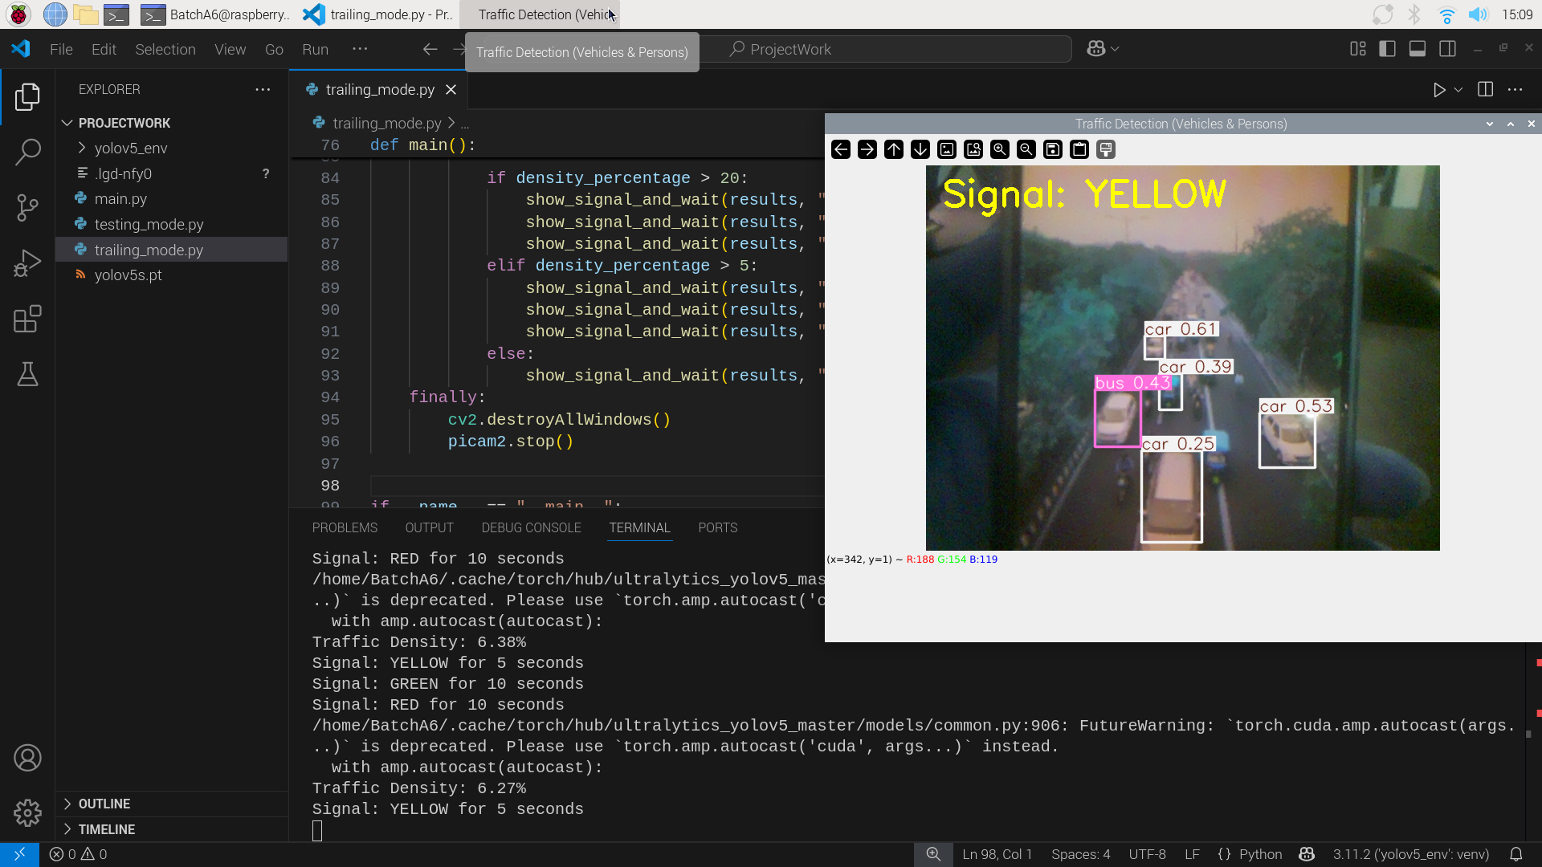
RESULTS :
The YOLO AI Model detecting the vehicles in the traffic and setting the timing for signals according to traffic. In this scenario, Vehicles are detecting When the traffic light is in “Yellow Color”. It is indicating the Vehicles are need to be ready to go. This Light indication will be only when before the Green Signal. Other wise it will not work.

Slide 16
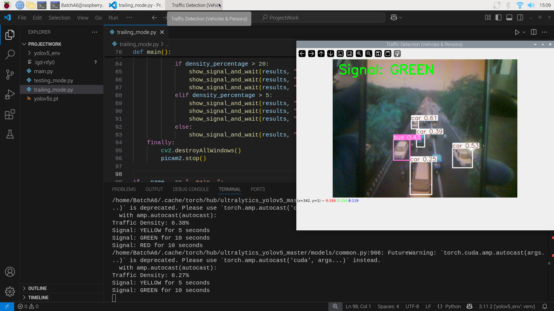
A green signal is prominently displayed, indicating that the current traffic density is low enough to allow vehicle movement. Supporting this, the terminal at the bottom logs traffic density percentages such as 6.38% and 6.27%, and shows corresponding signal changes like “YELLOW for 5 seconds” followed by “GREEN for 10 seconds.” Overall, the system demonstrates a well-implemented real-time traffic management solution. It combines computer vision and control logic to dynamically adjust signals based on vehicle detection, contributing toward intelligent traffic systems for smart city applications.

Slide 17
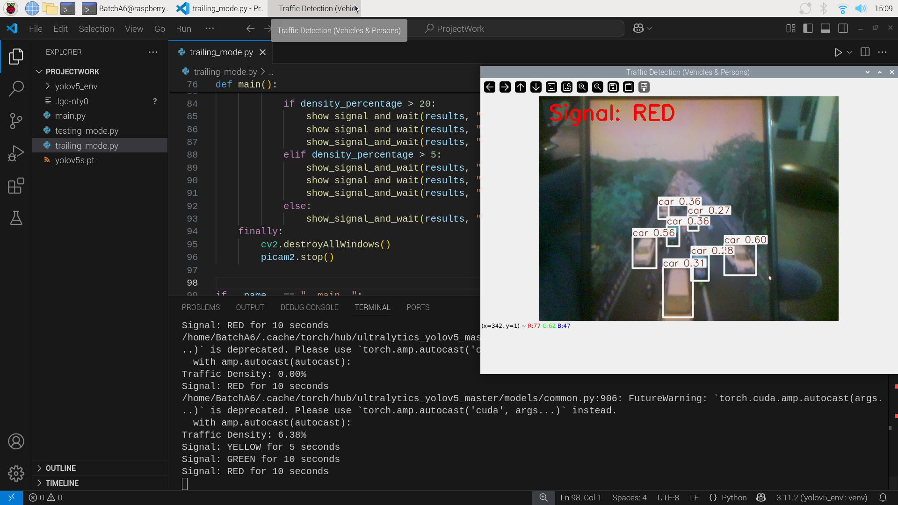
The YOLO AI Model detecting the vehicles in the traffic and setting the timing for signals according to traffic. In this scenario, Vehicles are detecting When the traffic light is in “RED COLOR”.

Slide 18
ADVANTAGES :
1. Reduces Traffic Congestion :
Dynamically adjusts signal timings based on real-time traffic conditions, reducing unnecessary waiting times.
2. Improves Traffic Flow Efficiency :
Prioritizes high-density lanes, ensuring smoother movement and reducing overall travel time.
3. Enhances Road Safety :
Adaptive signal control reduces the risk of accidents caused by sudden stops, aggressive driving, or unnecessary delays.
4. IoT and Smart City Integration :
Can be integrated with smart city infrastructure, enabling data-driven traffic control and future improvements.
5. Reduces Emergency Response Delays :
Can be programmed to give priority to emergency vehicles (ambulances, fire trucks, police) by adjusting signals accordingly.

Slide 19
DISADVANTAGES:
1. High Initial Cost :
Implementing advanced sensors (cameras, radar, infrared) and IoT technology requires significant investment.
2. Limited Effectiveness in Low Traffic Areas :
The system is most beneficial in high-density traffic zones; in low-traffic areas, it may not provide significant improvements over traditional signal systems.
3. Complex Implementation :
Requires integration of hardware (sensors, cameras) and software (AI algorithms, cloud systems).

Slide 20
APPLICATIONS :
1. Urban Traffic Management :
Optimizes signal timings at busy intersections, reducing congestion and improving traffic flow in cities.
2. Emergency Vehicle Priority System :
Detects ambulances, fire trucks, and police vehicles, giving them priority by adjusting traffic signals to ensure faster emergency response times.
3. Smart City Integration :
Works with IoT-based smart city infrastructure, providing real-time traffic data for better urban planning and decision-making.
4. Pollution and Fuel Consumption Reduction :
Reduces vehicle idle time at signals, lowering fuel consumption and cutting down harmful emissions, contributing to environmental sustainability.
5. Highway and Expressway Traffic Control:
Can be implemented at highway exits and toll plazas to manage traffic density and improve vehicle movement efficiency.

Slide 21
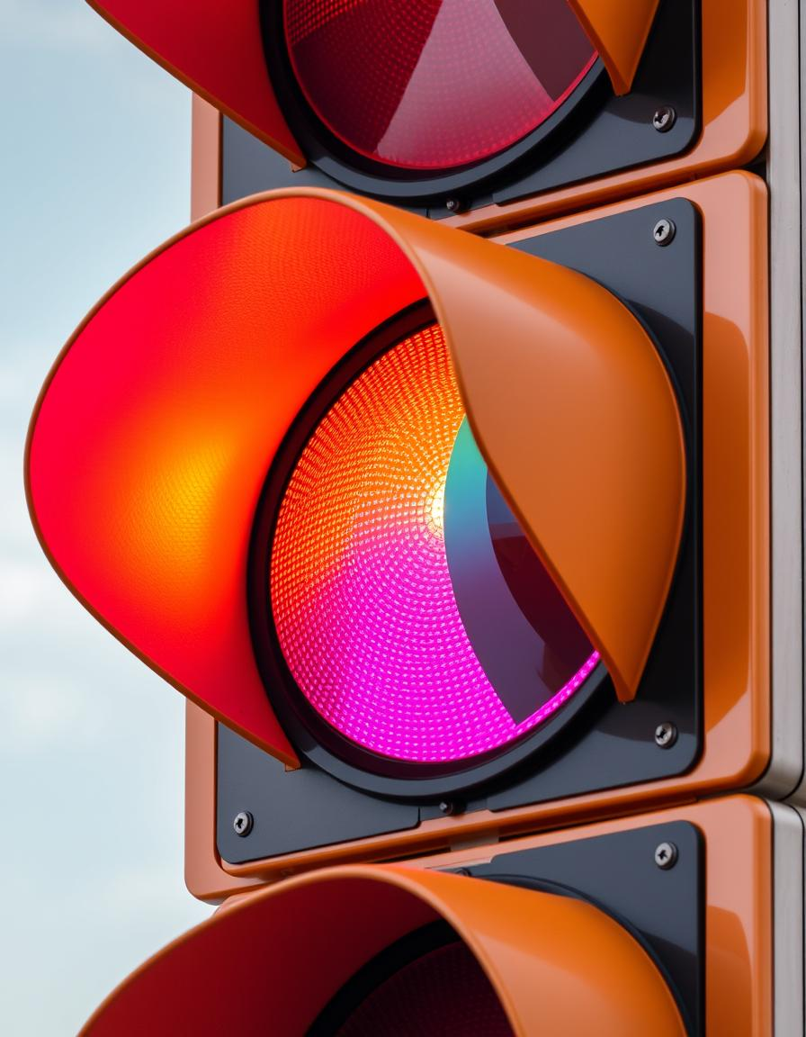
CONCLUSION:
The Traffic Density-Based Signal Timing Control System Improves urban traffic by adjusting signal timings based on the real-time traffic conditions. Using Sensors, IoT and machine Learning, It optimizes traffic flow, reduces congestion, and helps the environment. The System boosts transportation efficiency, lowers fuel use, and cuts emissions, offering a scalable solution for growing cities.

Slide 22


